Slide 1

Operating Systems and Linux Programming - M23DE0105
MCA Sem I - Academic Year : 2023 - 2024 ODD Semester

Slide 2
Lecture - 1

Slide 3
AGENDA
Introduction
Quick look at Syllabus – Unit 2
Introduction to Deadlocks

Slide 4

Quick Look at the Syllabus
Unit 2: Dead locks
Deadlocks: system model, Characterization, Deadlock prevention, avoidance and detection, Recovery from deadlock.
Memory Management: Logical and Physical address space, Swapping, Contiguous allocation, Paging, Segmentation, Segmentation with paging, Virtual memory -Demand paging and its performance, Page replacement algorithms, Allocation of frames, Thrashing.
07

Slide 5
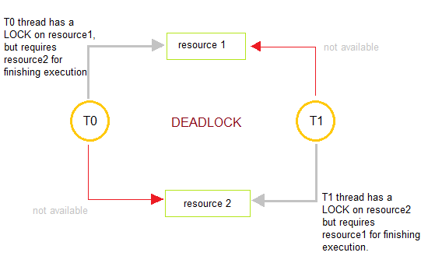
Introduction to Deadlocks
Deadlocks are a set of blocked processes each holding a resource and waiting to acquire a resource held by another process.
02

Slide 6
Introduction to Deadlocks
A system consists of a finite number of resources distributed among several competing processes.
The resources may be partitioned into several types (or classes), each consisting of some number of identical instances.
CPU cycles, files, and I/O devices (such as printers and DVD drives) are examples of resource types.
If a system has two CPUs, then the resource type CPU has two instances. Similarly, the resource type printer may have five instances.
02

Slide 7
Introduction to Deadlocks
If a process requests an instance of a resource type, the allocation of any instance of the type should satisfy the request.
If it does not, then the instances are not identical, and the resource type classes have not been defined properly.
02

Slide 8
Introduction to Deadlocks
A process must request a resource before using it and must release the resource after using it.
A process may request as many resources as it requires to carry out its designated task.
Obviously, the number of resources requested may not exceed the total number of resources available in the system.
In other words, a process cannot request three printers if the system has only two.
02

Slide 9
Introduction to Deadlocks
Under the normal mode of operation, a process may utilize a resource in only the following sequence:
Request. The process requests the resource. If the request cannot be granted immediately (for example, if the resource is being used by another process), then the requesting process must wait until it can acquire the resource.
Use. The process can operate on the resource (for example, if the resource is a printer, the process can print on the printer).
Release. The process releases the resource.
02

Slide 10
Introduction to Deadlocks
A set of processes is in a deadlocked state when every process in the set is waiting for an event that can be caused only by another process in the set.
The events with which we are mainly concerned here are resource acquisition and release.
The resources may be either physical resources (for example, printers, tape drives, memory space, and CPU cycles) or logical resources (for example, semaphores, mutex locks, and files).
02

Slide 11
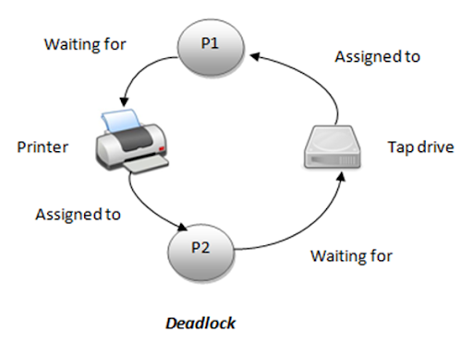
Introduction to Deadlocks
Deadlock Illustration
02

Slide 12
Lecture - 2

Slide 13
Recap
Introduction
Quick look at Syllabus – Unit 2
Introduction to Deadlocks

Slide 14
Agenda
Deadlock Characterization
Resource Allocation Graph

Slide 15
Deadlock Characterization
In a deadlock, processes never finish executing, and system resources are tied up, preventing other jobs from starting.
Features that characterize deadlocks:
Necessary Conditions
Mutual Exclusion. At least one resource must be held in a non-sharable mode; that is, only one process at a time can use the resource. If another process requests that resource, the requesting process must be delayed until the resource has been released.
Hold and wait. A process must be holding at least one resource and waiting to acquire additional resources that are currently being held by other processes.
02

Slide 16
Deadlock Characterization
Necessary Conditions
No Preemption Resources cannot be preempted; that is, a resource can be released only voluntarily by the process holding it, after that process.
Circular Wait A set {P0, P1, ..., Pn} of waiting processes must exist such that P0 is waiting for a resource held by P1, P1 is waiting for a resource held by P2, ..., Pn−1 is waiting for a resource held by Pn, and Pn is waiting for a resource held by P0.
02

Slide 17
Resource Allocation Graph
Deadlocks can be described more precisely in terms of a directed graph called a System Resource-allocation Graph.
This graph consists of a set of vertices V and a set of edges E.
The set of vertices V is partitioned into two different types of nodes:
  P = {P1, P2,,.., Pn } the set consisting of all the active processes in the system, and
  R = {R1, R2, •••, Rm}, the set consisting of all resource types in the system.
02

Slide 18
Resource Allocation Graph
A directed edge Pi —> Rj is called a request edge;
A directed edge Rj —> Pi is called an assignment edge.
02

Slide 19
Resource Allocation Graph
Pictorial Representation :
Process
Resource Type with 4 instances
P_{i} requests instance of R_{j}
P_{i} is holding an instance of R_{j}
P_{i}
P_{i}
02

Slide 20

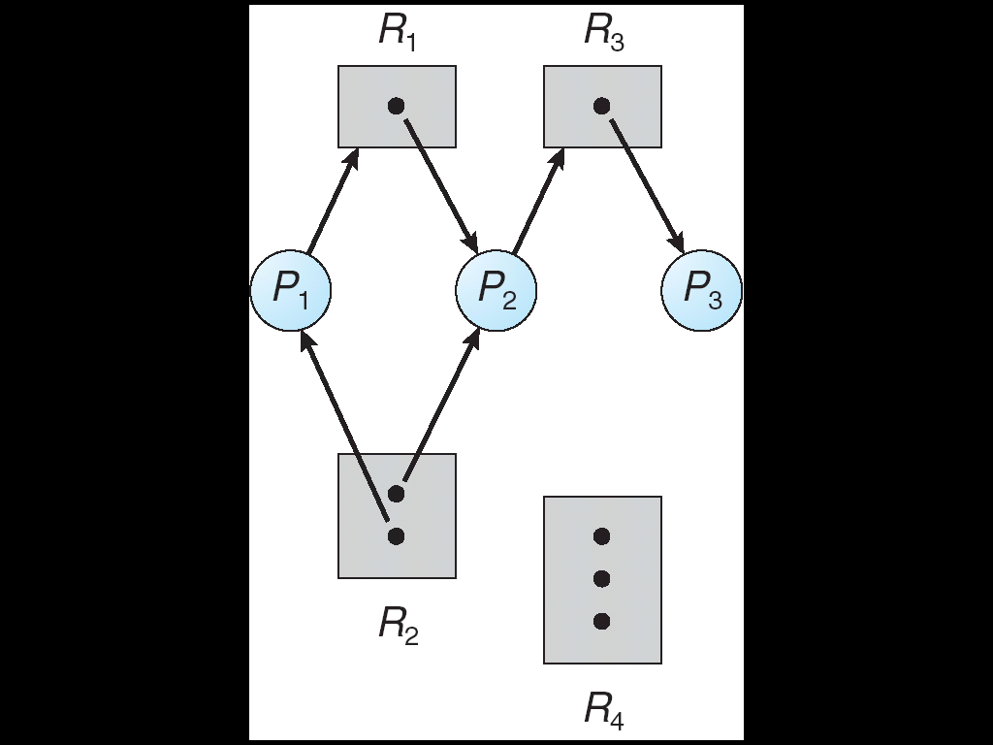

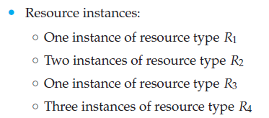
Resource Allocation Graph
02

Slide 21
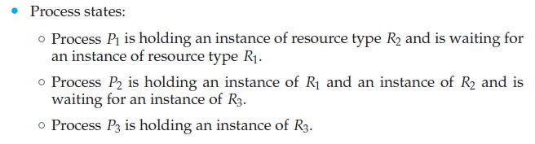
Resource Allocation Graph
02

Slide 22
Resource Allocation Graph
Defined a resource-allocation graph, it can be shown that, if the graph contains no cycles, no system process is deadlocked.
If the graph does contain a cycle, then a deadlock may exist.
02

Slide 23
Resource Allocation Graph
If each resource type has exactly one instance, then a cycle implies that a deadlock has occurred. If the cycle involves only a set of resource types, each with only a single instance, then a deadlock has occurred. Each process involved in the cycle is deadlocked. In this case, a cycle in the graph is both a necessary and a sufficient condition for the existence of deadlock.
If each resource type has several instances, then a cycle does not necessarily imply that a deadlock has occurred. In this case, a cycle in the graph is a necessary but not a sufficient condition for deadlock.
02

Slide 24
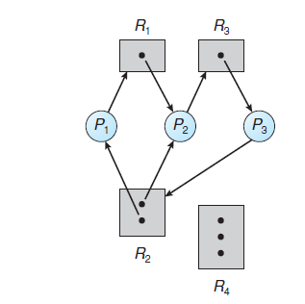

Resource Allocation Graph
Suppose that process P3 requests an instance of resource type R2.
Since no resource instance is currently available, we add a request edge P3→ R2 to the graph.
At this point, two minimal cycles exist in the system:
02

Slide 25
Resource Allocation Graph
Processes P1, P2, and P3 are deadlocked. Process P2 is waiting for the resource R3, which is held by process P3. Process P3 is waiting for either process P1 or process P2 to release resource R2.
In addition, process P1 is waiting for process P2 to release resource R1.
02

Slide 26
Lecture - 3

Slide 27
Recap
Deadlock Characterization
Resource Allocation Graph

Slide 28
Agenda
Methods of Handling Deadlock
  Prevention
  Avoidance

Slide 29
Methods of Handling Deadlock
The following are the methods using which we can handle deadlocks.:
Prevention
Avoidance
Detection
Do Nothing
02

Slide 30
Methods of Handling Deadlock
Deadlock Prevention
Deadlock prevention provides a set of methods for ensuring that at least one of the necessary conditions cannot hold.
Mutual Exclusion
Hold & Wait
No Preemption
Circular Wait
02

Slide 31
Methods of Handling Deadlock
Deadlock Prevention
Mutual Exclusion
not required for sharable resources (e.g., read-only files); must hold for non-sharable resources
Hold and Wait
must guarantee that whenever a process requests a resource, it does not hold any other resources
  Require the process to request and be allocated all its resources before it begins execution, or allow the process to request resources only when the process has none allocated to it.
  Low resource utilization; starvation possible
02

Slide 32
Methods of Handling Deadlock
Deadlock Prevention
No Preemption –
  If a process that is holding some resources requests another resource that cannot be immediately allocated to it, then all resources currently being held are released
  Preempted resources are added to the list of resources for which the process is waiting
  Process will be restarted only when it can regain its old resources, as well as the new ones that it is requesting
Circular Wait
  impose a total ordering of all resource types, and require that each process requests resources in an increasing order of enumeration
02

Slide 33
Methods of Handling Deadlock
Deadlock Avoidance
Deadlock-prevention algorithms, prevent deadlocks by limiting how requests can be made.
The limits ensure that at least one of the necessary conditions for deadlock cannot occur.
Possible side effects of preventing deadlocks by this method, however, are low device utilization and reduced system throughput.
02

Slide 34
Methods of Handling Deadlock
Deadlock Avoidance
An alternative method for avoiding deadlocks is to require additional information about how resources are to be requested.
For example, in a system with one tape drive and one printer, the system might need to know that process P will request first the tape drive and then the printer before releasing both resources, whereas process Q will request first the printer and then the tape drive.
02

Slide 35
Methods of Handling Deadlock
Deadlock Avoidance
Requires that the system has some additional a priori information available
Simplest and most useful model requires that each process declare the maximum number of resources of each type that it may need
The deadlock-avoidance algorithm dynamically examines the resource-allocation state to ensure that there can never be a circular-wait condition
Resource-allocation state is defined by the number of available and allocated resources, and the maximum demands of the processes
02

Slide 36
Methods of Handling Deadlock
Deadlock Avoidance – Safe State
When a process requests an available resource, system must decide if immediate allocation leaves the system in a safe state
System is in safe state if there exists a sequence <P₁, P₂, …, P_{n}> of ALL the processes in the systems such that for each P_{i}, the resources that P_{i} can still request can be satisfied by currently available resources + resources held by all the P_{j}, with j < I
02

Slide 37
Methods of Handling Deadlock
Deadlock Avoidance – Safe State
That is:
  If P_{i} resource needs are not immediately available, then P_{i} can wait until all P_{j} have finished
  When P_{j} is finished, P_{i} can obtain needed resources, execute, return allocated resources, and terminate
  When P_{i} terminates, P_{i +1} can obtain its needed resources, and so on
02

Slide 38
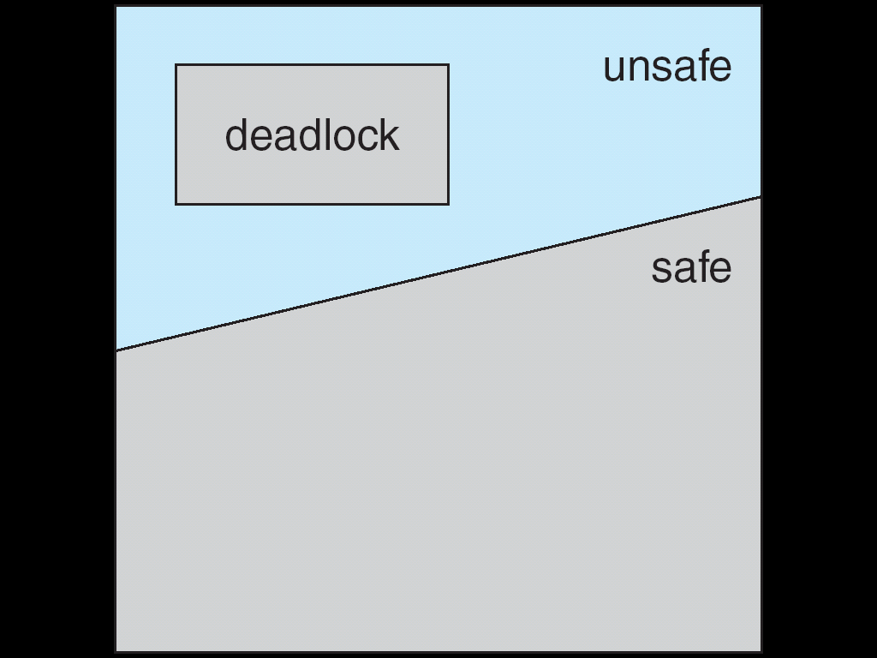
Methods of Handling Deadlock
Deadlock Avoidance – Safe State
If a system is in safe state ⇒ no deadlocks
If a system is in unsafe state ⇒ possibility of deadlock
Avoidance ⇒ ensure that a system will never enter an unsafe state.
02

Slide 39
Methods of Handling Deadlock
Deadlock Avoidance –
Avoidance Algorithms
For a single instance of a resource type, use a resource-allocation graph
For multiple instances of a resource type, use the banker’s algorithm
02

Slide 40
Methods of Handling Deadlock
Deadlock Avoidance –
Resource Allocation Graph Algorithm
If we have a resource-allocation system with only one instance of each resource type, we can use a variant of the resource-allocation graph for deadlock avoidance.
In addition to the request and assignment edges already described, we introduce a new type of edge, called a claim edge.
02

Slide 41
Methods of Handling Deadlock
Deadlock Avoidance –
Resource Allocation Graph Algorithm
Claim edge P_{i} → R_{j} indicated that process P_{i} may request resource R_{j}; represented by a dashed line.
Claim edge converts to request edge when a process requests a resource
Request edge converted to an assignment edge when the resource is allocated to the process
When a resource is released by a process, assignment edge reconverts to a claim edge
Resources must be claimed a priori in the system
02

Slide 42
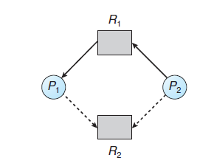
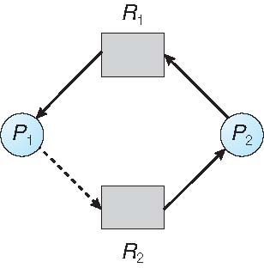
Methods of Handling Deadlock
Deadlock Avoidance –
Resource Allocation Graph Algorithm
02

Slide 43
Lecture - 4

Slide 44
Recap
Methods of Handling Deadlock
  Prevention
  Avoidance

Slide 45
Agenda
Methods of Handling Deadlock
  Avoidance
    Bankers Algorithm

Slide 46
Methods of Handling Deadlock
Deadlock Avoidance –
Banker’s Algorithm
The name was chosen because the algorithm could be used in a banking system to ensure that the bank never allocated its available cash in such a way that it could no longer satisfy the needs of all its customers.
02

Slide 47
Methods of Handling Deadlock
Deadlock Avoidance –
Banker’s Algorithm
When a new process enters the system, it must declare the maximum number of instances of each resource type that it may need.
This number may not exceed the total number of resources in the system.
When a user requests a set of resources, the system must determine whether the allocation of these resources will leave the system in a safe state.
If it will, the resources are allocated; otherwise, the process must wait until some other process releases enough resources.
02

Slide 48
Methods of Handling Deadlock
Deadlock Avoidance –
Data Structures for Banker’s Algorithm
Let n = number of processes, and m = number of resources types.
Available: Vector of length m. If available[j] = k, there are k instances of resource type R_{j} available
Max: n x m matrix. If Max[i,j] = k, then process P_{i} may request at most k instances of resource type R_{j}
Allocation: n x m matrix. If Allocation[i,j] = k then P_{i} is currently allocated k instances of R_{j}
Need: n x m matrix. If Need[i,j] = k, then P_{i} may need k more instances of R_{j} to complete its task
    Need [i,j] = Max[i,j] – Allocation [i,j]
02

Slide 49
Methods of Handling Deadlock
Deadlock Avoidance –
Banker’s Algorithm – Safety Algorithm.
Let Work and Finish be vectors of length m and n, respectively.
Initialize:
      Work = Available
      Finish [i] = false for i = 0, 1, …, n- 1
2. Find an i such that both:
  (a) Finish [i] = false
  (b) Need_{i} ≤ Work
  If no such i exists, go to step 4
3. Work = Work + Allocation_{i}
Finish[i] = true
go to step 2
4. If Finish [i] == true for all i, then the system is in a safe state
02

Slide 50
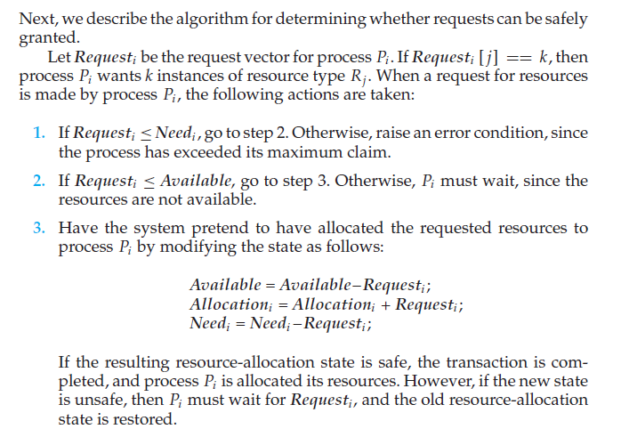
Methods of Handling Deadlock
Deadlock Avoidance –
Resource-Request Algorithm
02

Slide 51
Methods of Handling Deadlock
Deadlock Avoidance –
Banker’s Algorithm – Example.
5 processes P₀ through P₄;
3 resource types:
A (10 instances), B (5instances), and C (7 instances)
Snapshot at time T₀:
Allocation Max Available
A B C A B C A B C
P₀ 0 1 0 7 5 3 3 3 2
P₁ 2 0 0 3 2 2
P₂ 3 0 2 9 0 2
P₃ 2 1 1 2 2 2
P₄ 0 0 2 4 3 3
02
https://www.youtube.com/watch?v=2V2FfP_olaA

Slide 52
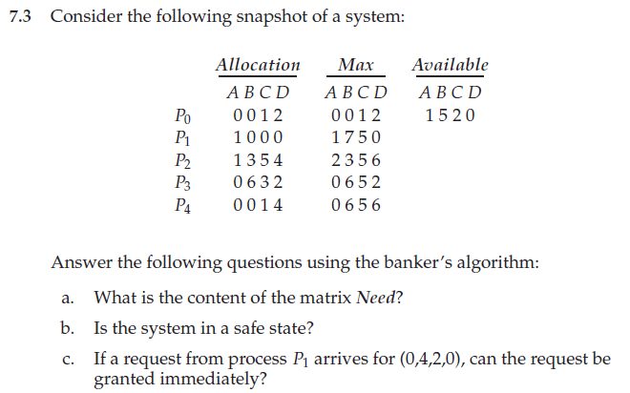
Methods of Handling Deadlock
Deadlock Avoidance –
Banker’s Algorithm – Example.
02

Slide 53
Lecture - 5

Slide 54
Recap
Methods of Handling Deadlock
  Avoidance
    Bankers Algorithm

Slide 55
Agenda
Deadlock Detection
Recovery from Deadlock

Slide 56
Deadlock Detection
If a system does not employ either a deadlock-prevention or a deadlock avoidance algorithm, a deadlock situation may occur. In this environment, the system may provide:
An algorithm that examines the state of the system to determine whether a deadlock has occurred.
An algorithm to recover from the deadlock.
02

Slide 57
Deadlock Detection
Two Case:
Systems with only a single instance of each resource type
Systems with several instances of each resource type.
02

Slide 58
Deadlock Detection
Single Instance Of Each Resource Type
If all resources have only a single instance, then we can define a deadlock detection
algorithm that uses a variant of the resource-allocation graph, called a wait-for graph.
We obtain this graph from the resource-allocation graph by removing the resource nodes and collapsing the appropriate edges.
02

Slide 59
Deadlock Detection
Single Instance Of Each Resource Type
Pi → Pj = implies that process Pi is waiting for process Pj to release a resource that Pi needs.
An edge Pi → Pj exists in a wait-for graph if and only if the corresponding resource allocation graph contains two edges Pi → Rq and Rq → Pj for some resource Rq .
02

Slide 60
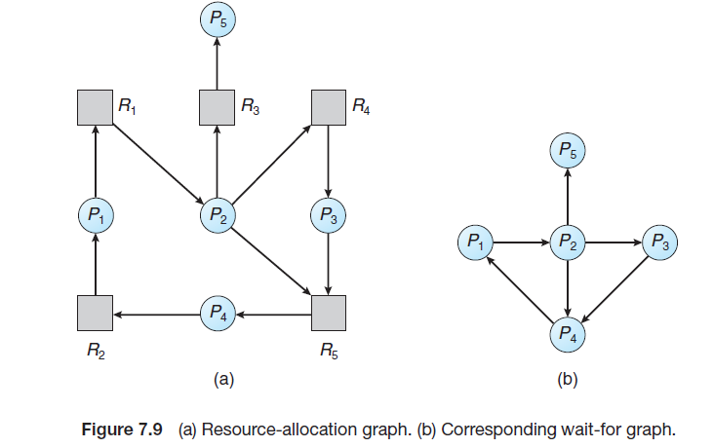
Deadlock Detection
Single Instance Of Each Resource Type
An edge Pi → Pj exists in a wait-for graph if and only if the corresponding resource allocation graph contains two edges Pi → Rq and Rq → Pj for some resource Rq .
02

Slide 61
Deadlock Detection
Single Instance Of Each Resource Type
A deadlock exists in the system if and only if the wait-for graph contains a cycle.
To detect deadlocks, the system needs to maintain the wait-for graph and periodically invoke an algorithm that searches for a cycle in the graph.
An algorithm to detect a cycle in a graph requires an order of n2 operations, where n is the number of vertices in the graph.
02

Slide 62
Deadlock Detection
Several Instances Of A Resource Type
The wait-for-graph scheme does not apply to a resource-allocation system with multiple instances of each resource type.
02

Slide 63
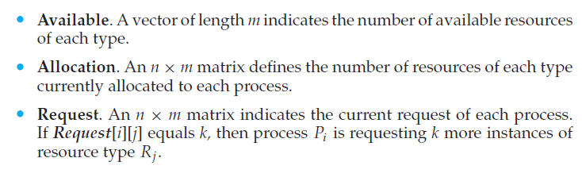
Deadlock Detection
Several Instances Of A Resource Type
Detection Algorithm Data Structures
02

Slide 64
Deadlock Detection
Several Instances Of A Resource Type
Detection Algorithm
The detection algorithm described here simply investigates every possible allocation sequence for the processes that remain to be completed.
02

Slide 65
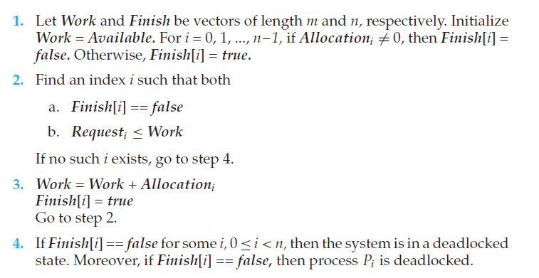
Deadlock Detection
Several Instances Of A Resource Type
Detection Algorithm
02

Slide 66
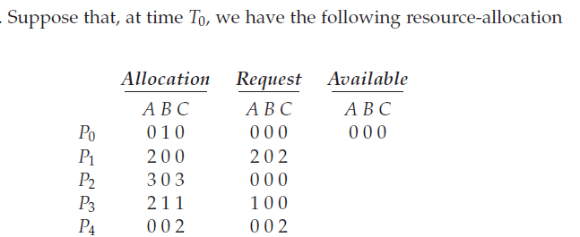

Deadlock Detection
Several Instances Of A Resource Type
Detection Algorithm
02

Slide 67
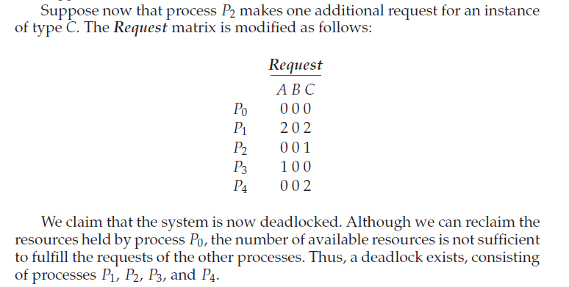
Deadlock Detection
Several Instances Of A Resource Type
Detection Algorithm
02

Slide 68
Lecture - 6

Slide 69
Recap
Deadlock Detection

Slide 70
Agenda
Recovery from Deadlock

Slide 71
Recovery from Deadlock
When a detection algorithm determines that a deadlock exists, several alternatives are available.
  Inform the operator that a deadlock has occurred and to let the operator deal with the deadlock manually.
  Let the system recover from the deadlock automatically.
02

Slide 72
Recovery from Deadlock
There are two options for breaking a deadlock.
  Simply abort one or more processes to break the circular wait.
  To preempt some resources from one or more of the deadlocked processes.
02

Slide 73
Recovery from Deadlock
Process Termination
To eliminate deadlocks by aborting a process, we use one of two methods. In both methods, the system reclaims all resources allocated to the terminated processes.
Abort all deadlocked processes. This method clearly will break the deadlock cycle but at great expense. The deadlocked processes may have been computed for a long time, and the results of these partial computations must be discarded and probably will have to be recomputed later.
02

Slide 74
Recovery from Deadlock
Process Termination
2. Abort one process at a time until the deadlock cycle is eliminated. This method incurs considerable overhead, since after each process is aborted, a deadlock-detection algorithm must be invoked to determine whether any processes are still deadlocked.
02

Slide 75
Recovery from Deadlock
Resource Preemption
To eliminate deadlocks using resource preemption, we successively preempt some resources from processes and give these resources to other processes until the deadlock cycle is broken.
If preemption is required to deal with deadlocks, then three issues need to be addressed:
02

Slide 76
Recovery from Deadlock
Resource Preemption
Selecting a victim. Which resources and which processes are to be preempted? As in process termination, we must determine the order of preemption to minimize cost.
Cost factors may include such parameters as the number of resources a deadlocked process is holding and the amount of time the process has thus far consumed.
02

Slide 77
Recovery from Deadlock
Resource Preemption
2. Rollback. If we preempt a resource from a process, what should be done with that process? It cannot continue with its normal execution; it is missing some needed resources. We must roll back the process to some safe state and restart it from that state.
Since, in general, it is difficult to determine what a safe state is, the simplest solution is a total rollback: abort the process and then restart it.
02

Slide 78
Recovery from Deadlock
Resource Preemption
3. Starvation. How do we ensure that starvation will not occur? That is, how can we guarantee that resources will not always be preempted from the same process?
In a system where victim selection is based primarily on cost factors, The same process may be always picked as a victim. As a result, this process never completes its designated task, a starvation situation any practical system must address. We must ensure that a process can be picked as a victim only a (small) finite number of times. The most common solution is to include the number of rollbacks in the cost factor.
02

Slide 79
Lecture - 7

Slide 80
Recap
Recovery from Deadlock

Slide 81
Agenda
Memory Management:
  Logical and Physical address space

Slide 82
Memory Management
Introduction
Memory consists of a large array of bytes, each with its address.
The CPU fetches instructions from memory according to the value of the program counter.
These instructions may cause additional loading from and storing to specific memory addresses.
02

Slide 83
Memory Management
Introduction
A typical instruction-execution cycle, for example, first fetches an instruction from memory.
The instruction is then decoded and may cause operands to be fetched from memory.
After the instruction has been executed on the operands, results may be stored back in memory.
02

Slide 84
Memory Management
Introduction
02

Slide 85
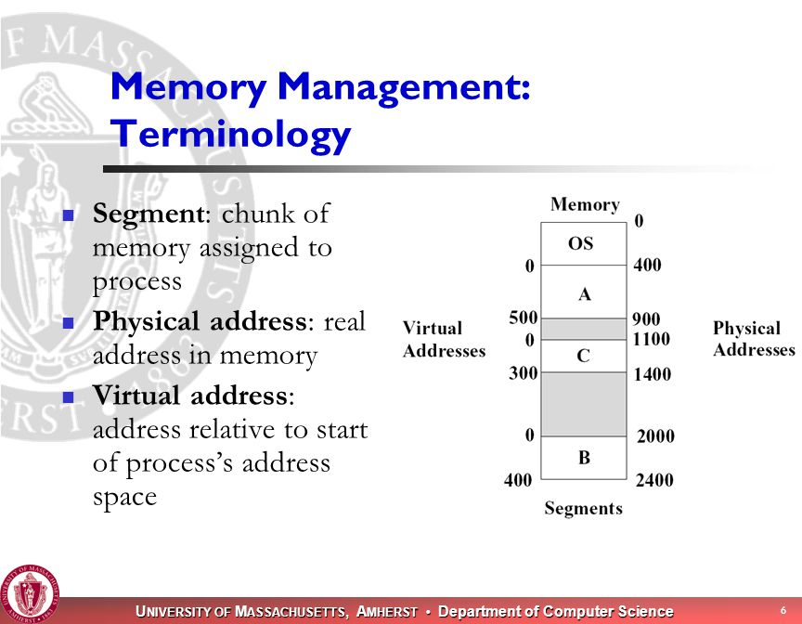
Memory Management
Introduction
02

Slide 86
Memory Management
Introduction
Program must be brought (from disk) into memory and placed within a process for it to be run.
Main memory and registers are the only storage CPU can access directly.
Memory unit only sees a stream of addresses + read requests, or address + data and write requests
Register access in one CPU clock (or less)
Main memory can take many cycles, causing a stall
Cache sits between main memory and CPU registers.
Protection of memory required to ensure correct operation.
02

Slide 87
Memory Management
Basic Hardware
The basic hardware can be studied for 3 parameters:
Speed
Access
Protection
02

Slide 88
Memory Management
Speed
Basic Hardware
Some registers are built into the CPU & they are generally accessible within one cycle of the CPU clock.
But completing memory access may take many cycles of the CPU clock.
In such cases the processor needs to stall since it does not have the data required to complete the instruction that it is executing.
The remedy is to add fast memory between the CPU and main memory.
This memory buffer is called Cache.
02

Slide 89
Memory Management
2. Access
Basic Hardware
With the relative speed of accessing physical memory, we also must ensure correct operation.
For proper system operation we must protect the operating system from access by user processes.
On multiuser systems, we must additionally protect user processes from one another.
This protection must be provided by the hardware because the operating system doesn’t usually intervene between the CPU and its memory accesses
02

Slide 90
Memory Management
2. Access
Basic Hardware
Make sure that each process has a separate memory space.
Separate per-process memory space protects the processes from each other and is fundamental to having multiple processes loaded in memory for concurrent execution.
For separate memory spaces, we need the ability to determine the range of legal addresses that the process may access and to ensure that the process can access only these legal addresses.
This protection is provided using two registers, usually a base and a limit register.
02

Slide 91
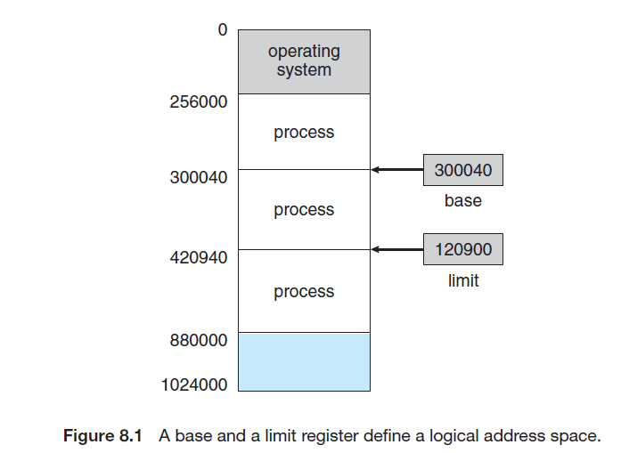
Memory Management
2. Access
Basic Hardware
The base register holds the smallest legal physical memory address;
the limit register specifies the size of the range
02

Slide 92
Memory Management
3. Protection
Basic Hardware
Protection of memory space is accomplished by having the CPU hardware compare every address generated in user mode with the registers.
Any attempt by a program executing in user mode to access operating-system memory or other users’ memory results in a trap to the operating system, which treats the attempt as a fatal error
02

Slide 93
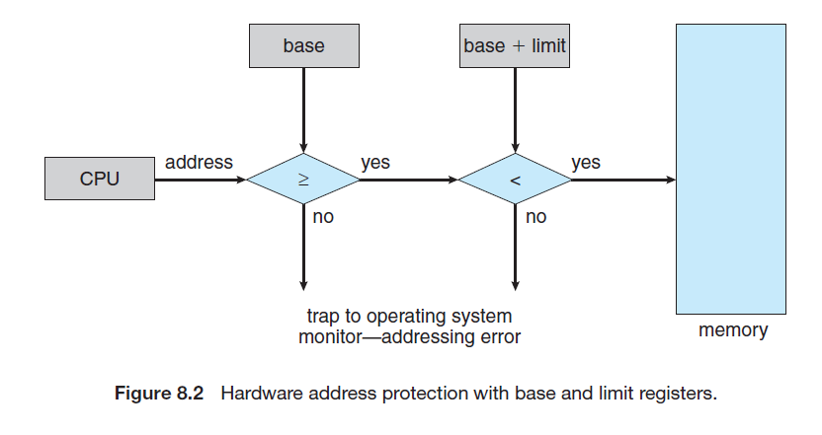
Memory Management
3. Protection
Basic Hardware
02

Slide 94
Memory Management
Address Binding
Address Binding is a mapping from one address space to another.
The processes on the disk that are waiting to be brought into memory for execution form the input queue.
02

Slide 95
Memory Management
Address Binding
Most systems allow a user process to reside in any part of the physical memory.
Thus, although the address space of the computer may start at 00000, the first address of the user process need not be 00000.
02

Slide 96
Memory Management
Address Binding
In most cases, a user program goes through several steps—some of which may be optional—before being executed.
Addresses may be represented in different ways during these steps. Addresses in the source program are generally symbolic (such as the variable count).
A compiler typically binds these symbolic addresses to relocatable addresses (such as “14 bytes from the beginning of this module”).
The linkage editor or loader in turn binds the relocatable addresses to absolute addresses (such as 74014).
Each binding is a mapping from one address space to another.
02

Slide 97
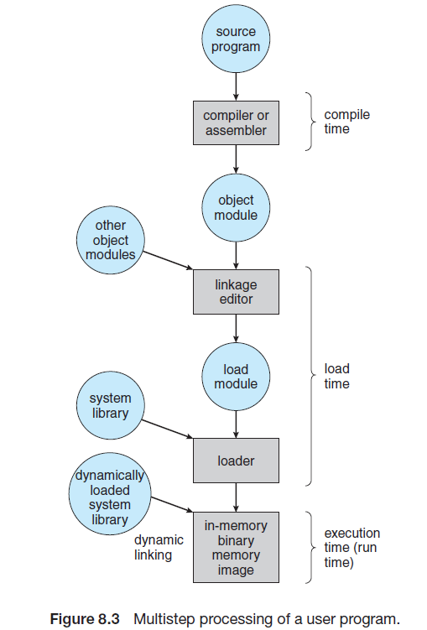
Memory Management
Address Binding
Compile time. If you know at compile time where the process will reside in memory, then absolute code can be generated.
Load time. If it is not known at compile time where the process will reside in memory, then the compiler must generate relocatable code.
Execution time. If the process can be moved during its execution from one memory segment to another, then binding must be delayed until run time.
02

Slide 98
Memory Management
Logical Versus Physical Address Space
Logical address - An address generated by the CPU
Physical address - an address seen by the memory unit—that is, the one loaded into the memory address register of the memory
02

Slide 99
Memory Management
Logical Versus Physical Address Space
The compile-time and load-time address-binding methods generate identical logical and physical addresses.
However, the execution-time address binding scheme results in differing logical and physical addresses.
In this case, we usually refer to the logical address as a virtual address.
We use logical address and virtual address interchangeably
02

Slide 100
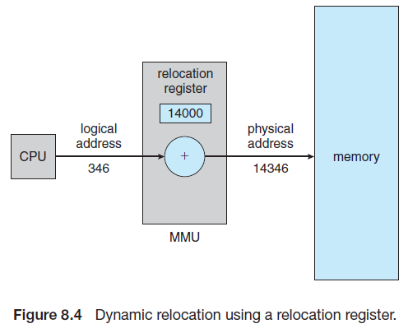
Memory Management
Logical Versus Physical Address Space
The run-time mapping from virtual to physical addresses is done by a hardware device called the memory-management unit (MMU).
02

Slide 101
Memory Management
Swapping
A process must be in memory to be executed.
A process, however, can be swapped temporarily out of memory to a backing store and then brought back into memory for continued execution.
Swapping makes it possible for the total physical address space of all processes to exceed the real physical memory of the system, thus increasing the degree of multiprogramming in a system.
02

Slide 102
Memory Management
Swapping
Swapping can be of 2 types:
Standard Swapping
Mobile Swapping
02

Slide 103
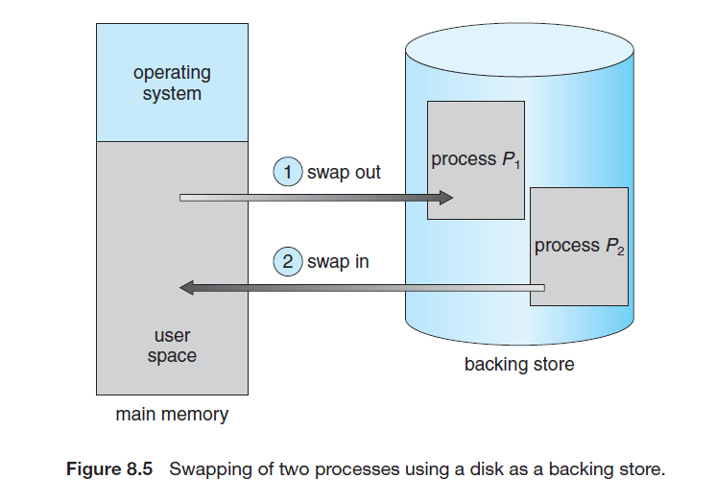
Memory Management
Swapping - Standard Swapping
Standard swapping involves moving processes between main memory and a backing store.
02

Slide 104
Memory Management
Swapping - Standard Swapping
The system maintains a ready queue consisting of all processes whose memory images are on the backing store or in memory and are ready to run.
Whenever the CPU scheduler decides to execute a process, it calls the dispatcher.
The dispatcher checks to see whether the next process in the queue is in memory.
If it is not, and if there is no free memory region, the dispatcher swaps out a process currently in memory and swaps in the desired process.
It then reloads registers and transfers control to the selected process.
02

Slide 105
Memory Management
Swapping - Standard Swapping
Context Switch time for Swapping – Go Through
02

Slide 106
Memory Management
Swapping – Mobile Systems
Flash memory is a type of non-volatile computer memory that can store data even when there is no power.
Memory cards: SD cards, microSD cards, memory sticks, and CompactFlash cards
Mobile systems typically do not support swapping in any form.
Mobile devices generally use flash memory rather than more spacious hard disks as their persistent storage.
Instead of using swapping, when free memory falls below a certain threshold, Apple’s iOS asks applications to voluntarily relinquish allocated memory.
Read-only data (such as code) are removed from the system and later reloaded from flash memory if necessary
02

Slide 107
Lecture - 9

Slide 108
Recap
Memory Management:
  Address Binding
  Logical and Physical address space
  Swapping

Slide 109
Agenda
Memory Management:
  Contiguous Memory Allocation
  Fragmentation

Slide 110
Memory Management
Contiguous Memory Allocation
In contiguous memory allocation, each process is contained in a single section of
memory that is contiguous to the section containing the next process.
02

Slide 111
Memory Management
Contiguous Memory Allocation
Multiple-partition allocation
  Degree of multiprogramming limited by number of partitions
  Variable-partition sizes for efficiency (sized to a given process’ needs)
  Hole – block of available memory; holes of various size are scattered throughout memory
  When a process arrives, it is allocated memory from a hole large enough to accommodate it
  Process exiting frees its partition, adjacent free partitions combined
  Operating system maintains information about:
  a) allocated partitions b) free partitions (hole)
02

Slide 112
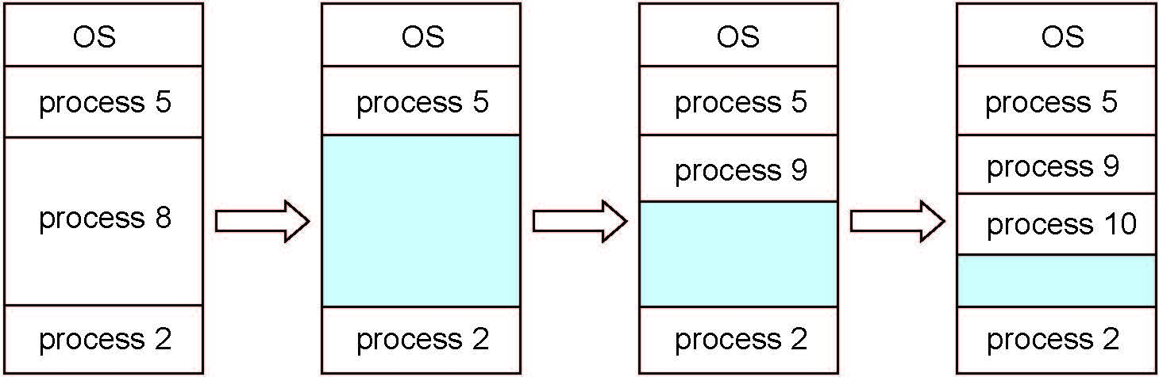
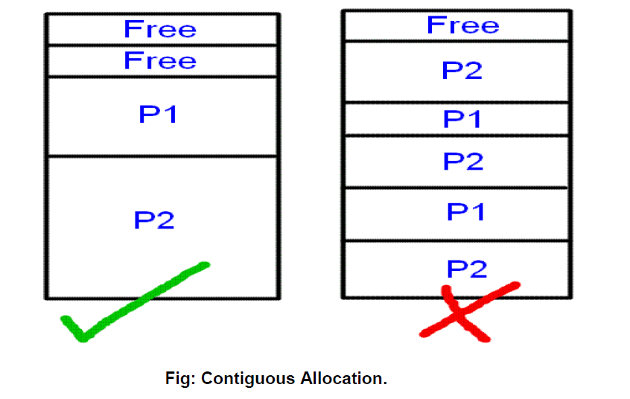
Memory Management
Contiguous Memory Allocation
02

Slide 113
Memory Management
Contiguous Memory Allocation
How to satisfy a request of size n from a list of free holes?
First-fit: Allocate the first hole that is big enough
Best-fit: Allocate the smallest hole that is big enough; must search entire list, unless ordered by size
  Produces the smallest leftover hole
Worst-fit: Allocate the largest hole; must also search entire list
  Produces the largest leftover hole
02

Slide 114
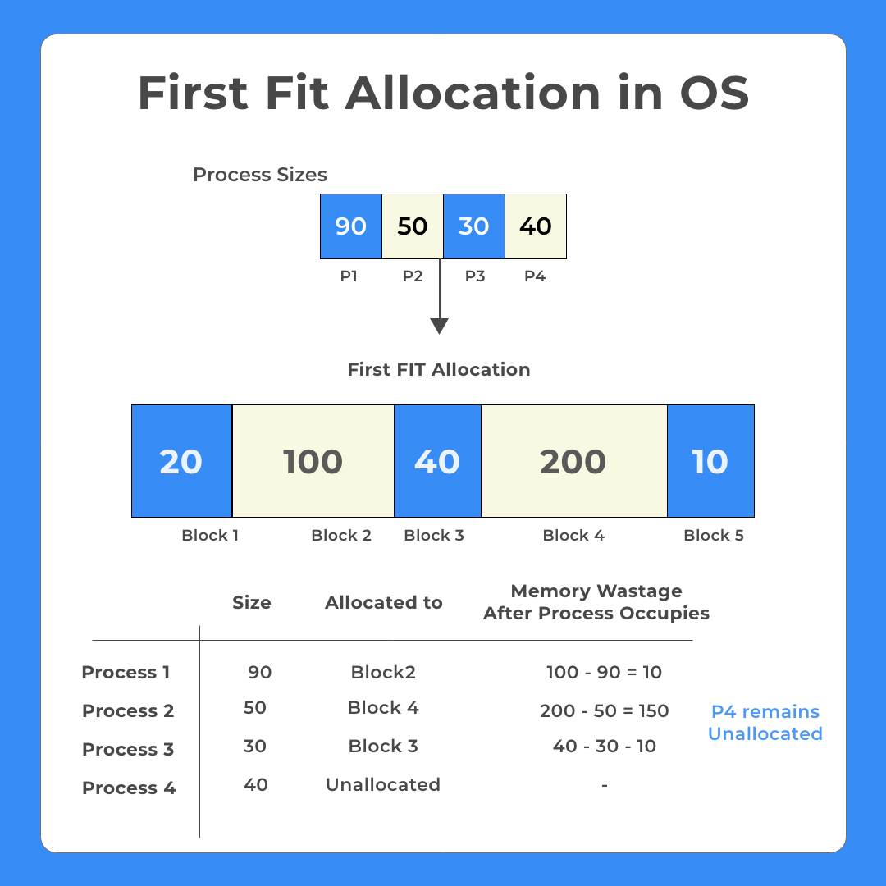

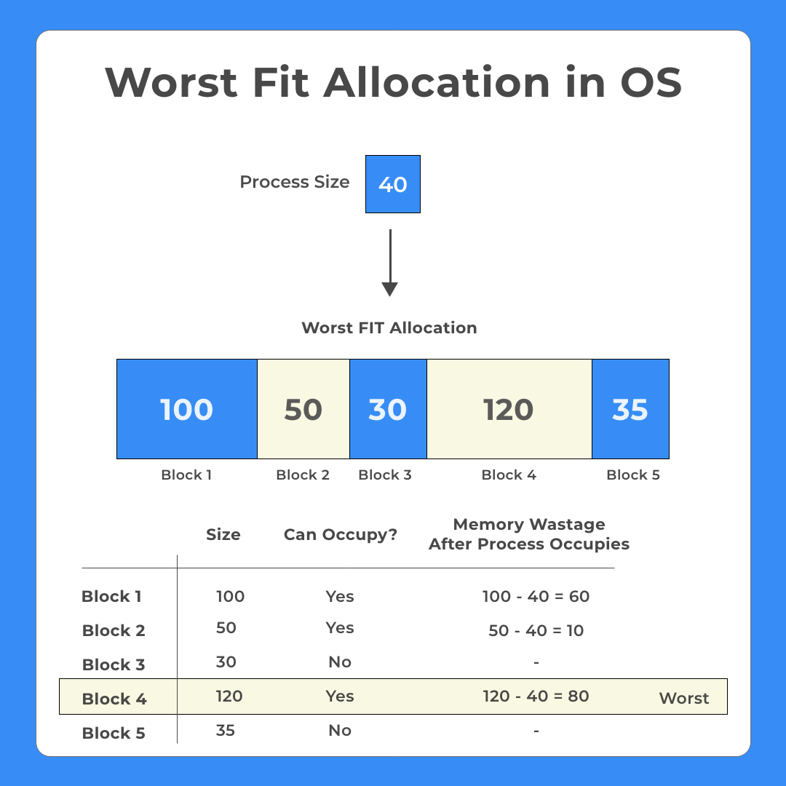
Memory Management
Contiguous Memory Allocation
02

Slide 115
Lecture - 10

Slide 116
Recap
Memory Management:
  Contiguous Memory Allocation

Slide 117
Agenda
Memory Management:
  Fragmentation
  Compaction
  Segmentation

Slide 118
Memory Management
Fragmentation
Memory space in the system constantly goes through loading and releasing processes and their resources because of which the total memory spaces get broken into a lot of small pieces, this causes the creation of small non-utilized fragmented memory spaces, which are so small that normal processes can not fit into those small fragments, causing those memory spaces not getting utilized at all, this is called memory Fragmentation in the operating system.
02
https://prepinsta.com/operating-systems/fragmentation/

Slide 119
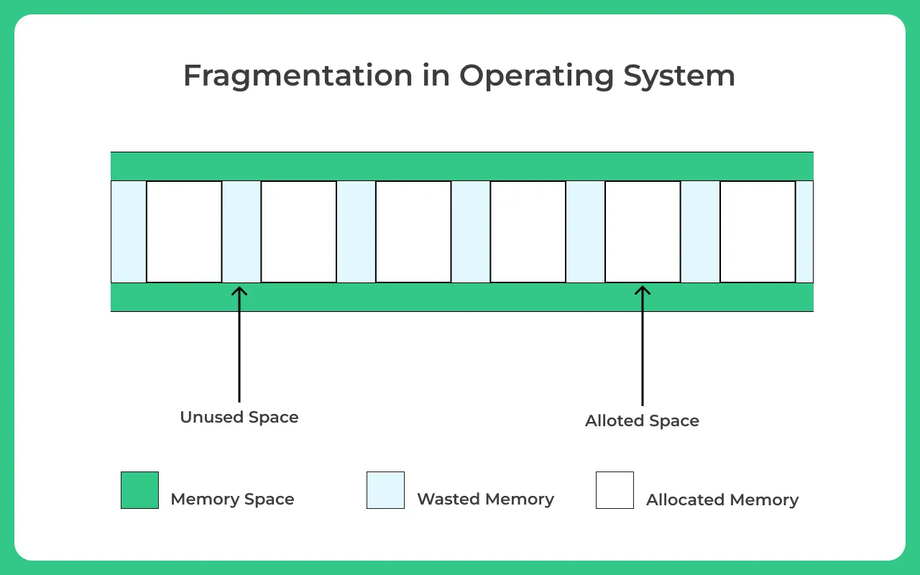
Memory Management
Fragmentation
02
https://prepinsta.com/operating-systems/fragmentation/

Slide 120
Memory Management
Fragmentation
Fragmentation is of the following two types –
Internal Fragmentation
External Fragmentation
02
https://prepinsta.com/operating-systems/fragmentation/

Slide 121
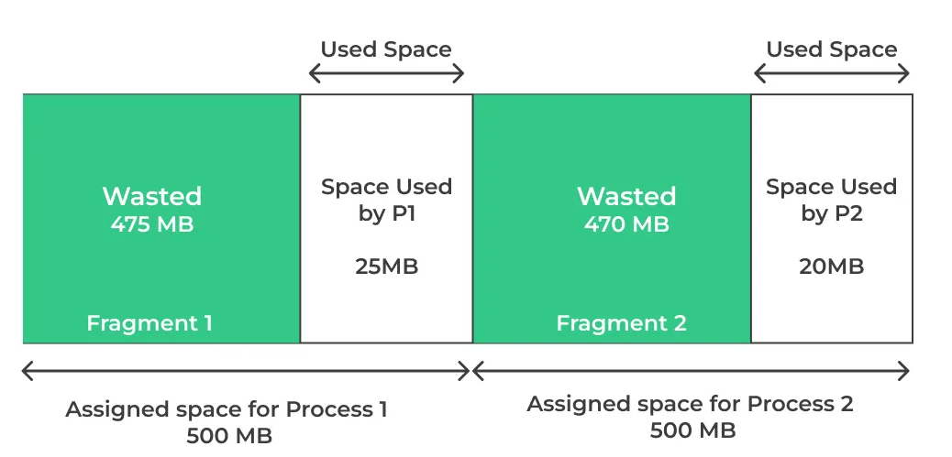
Memory Management
Fragmentation – Internal Fragmentation
The memory block assigned can comfortably fill in the process space but the assigned size is way bigger than the required size, so waste of memory occurs
02
https://prepinsta.com/operating-systems/fragmentation/

Slide 122
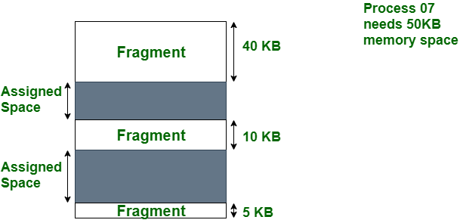
Memory Management
Fragmentation – External Fragmentation
The memory space in the system can comfortably satisfy the processes, but the available memory space is non-contiguous, thus it further can’t be utilized.
02
https://prepinsta.com/operating-systems/fragmentation/

Slide 123
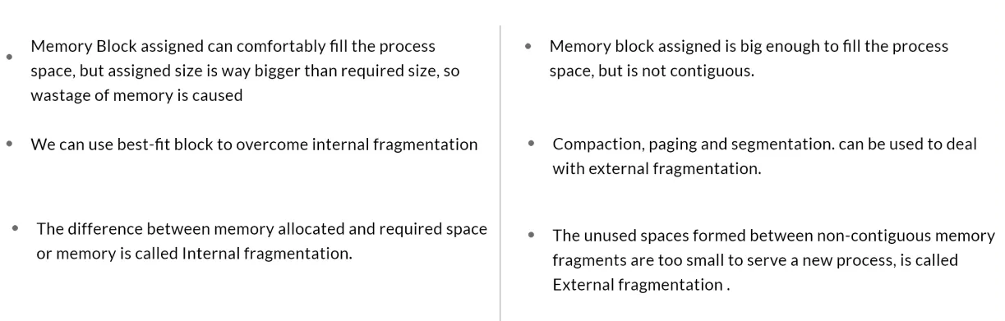
Memory Management
Difference Between Internal and External Fragmentation
Internal Fragmentation
External Fragmentation
02
https://prepinsta.com/operating-systems/fragmentation/

Slide 124
Memory Management
Compaction
One solution to the problem of external fragmentation is compaction.
The goal is to shuffle the memory contents to place all free memory together in one large block.
02

Slide 125
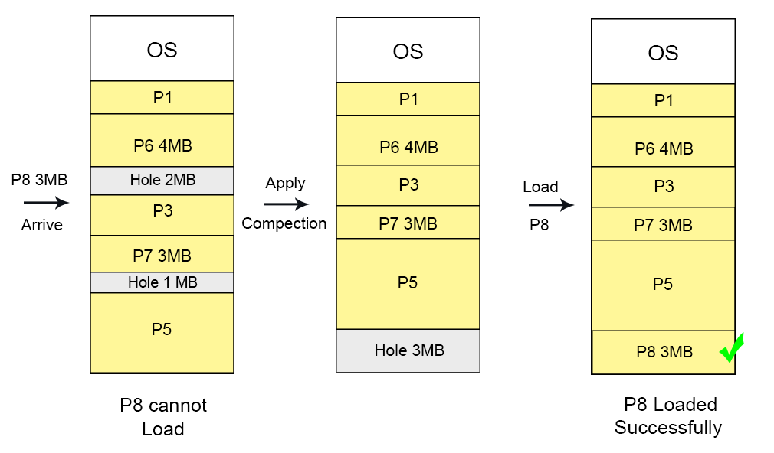
Memory Management
Compaction
02

Slide 126
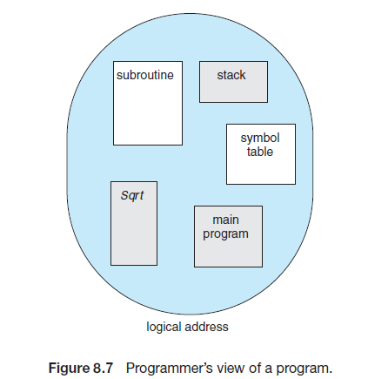
Memory Management
Segmentation
Segmentation is a memory-management scheme that supports this programmer view of memory.
A logical address space is a collection of segments.
02

Slide 127
Memory Management
Segmentation
Each segment has a name and a length.
The addresses specify both the segment name and the offset within the segment.
For simplicity of implementation, segments are numbered and are referred to by a segment number, rather than by a segment name.
Thus, a logical address consists of a two tuple:
<segment-number, offset>
02

Slide 128
Memory Management
Segmentation
A C compiler might create separate segments for the following:
1. The code
2. Global variables
3. The heap, from which memory is allocated
4. The stacks used by each thread
5. The standard C library
02

Slide 129
Memory Management
Segmentation Hardware
The programmer refer to objects in the program by a two-dimensional address, the actual physical memory is still, a one dimensional sequence of bytes.
Thus, we must define an implementation to map two-dimensional user-defined addresses into one-dimensional physical addresses.
This mapping is effected by a segment table.
02

Slide 130
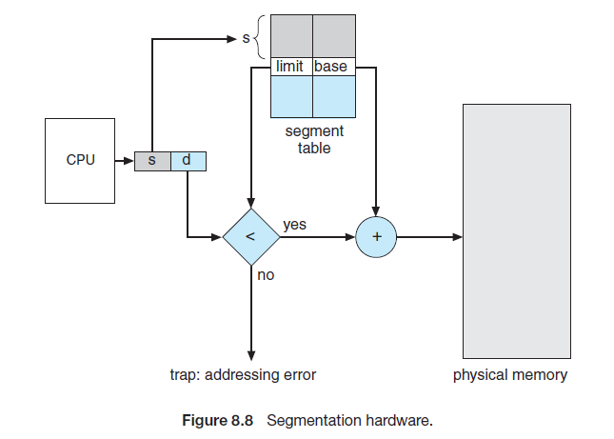
Memory Management
Segmentation Hardware
02

Slide 131
Memory Management
Segmentation Hardware
Each entry in the segment table has a segment base and a segment limit.
The segment base contains the starting physical address where the segment resides in memory, and the segment limit specifies the length of the segment.
02

Slide 132
Memory Management
Segmentation Hardware
The use of a segment table is illustrated in Figure 8.8.
A logical address consists of two parts: a segment number, s, and an offset into that segment, d.
The segment number is used as an index to the segment table.
The offset d of the logical address must be between 0 and the segment limit.
If it is not, we trap to the operating system (logical addressing attempt beyond end of segment).
02

Slide 133
Memory Management
Segmentation Hardware
When an offset is legal, it is added to the segment base to produce the address in physical memory of the desired byte.
The segment table is thus essentially an array of base–limit register pairs.
02

Slide 134
Memory Management
Segmentation Hardware
Consider the situation shown in Figure 8.9.
We have five segments numbered from 0 through 4.
The segments are stored in physical memory as shown.
The segment table has a separate entry for each segment, giving the beginning address of the segment in physical memory (or base) and the length of that segment (or limit).
02

Slide 135
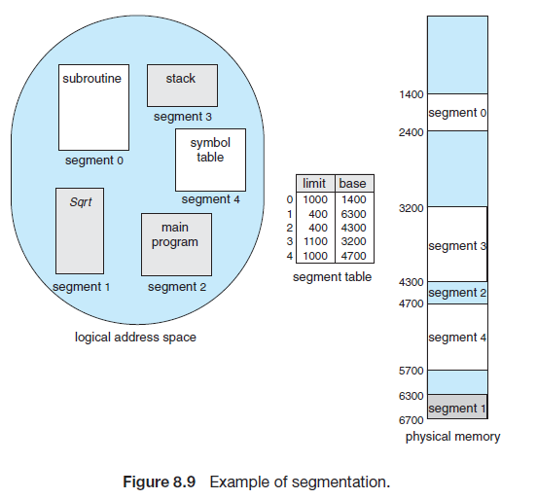
Memory Management
Segmentation Hardware
For example, segment 2 is 400 bytes long and begins at location 4300. Thus, a reference to byte 53 of segment 2 is mapped onto location 4300 + 53 = 4353.
A reference to segment 3, byte 852, is mapped to 3200 (the base of segment 3) + 852 = 4052.
A reference to byte 1222 of segment 0 would result in a trap to the operating system, as this segment is only 1,000 bytes long.
02

Slide 136
Lecture - 11

Slide 137
Recap
Memory Management:
  Fragmentation
  Compaction
  Segmentation

Slide 138
Agenda
Memory Management:
  Paging

Slide 139
Memory Management
Paging
Paging permits the physical address space of a process to be noncontiguous.
Paging avoids external fragmentation and the need for compaction, whereas segmentation does not.
Most memory-management schemes (Swapping, Segmentation ) suffered from this problem.
The problem arises because space must be found on the backing store when code fragments or data residing in the main memory need to be swapped out. The backing store has the same fragmentation problems.
02

Slide 140
Memory Management
Paging – Basic Method
Physical address space of a process can be noncontiguous; process is allocated physical memory whenever the latter is available
  Avoids external fragmentation
  Avoids the problem of varying sized memory chunks
Divide physical memory into fixed-sized blocks called frames
  Size is power of 2, between 512 bytes and 16 Mbytes
Divide logical memory into blocks of the same size called pages
02

Slide 141
Memory Management
Paging – Basic Method
Keep track of all free frames
To run a program of size N pages, need to find N free frames and load the program
Set up a page table to translate logical to physical addresses
Backing store likewise split into pages
Still have Internal fragmentation
02

Slide 142
Memory Management
Paging – Basic Method
Address generated by CPU is divided into:
  Page number (p) – used as an index into a page table which contains the base address of each page in physical memory
  Page offset (d) – combined with base address to define the physical memory address that is sent to the memory unit
  For given logical address space 2^{m} and page size 2^{n}
02

Slide 143
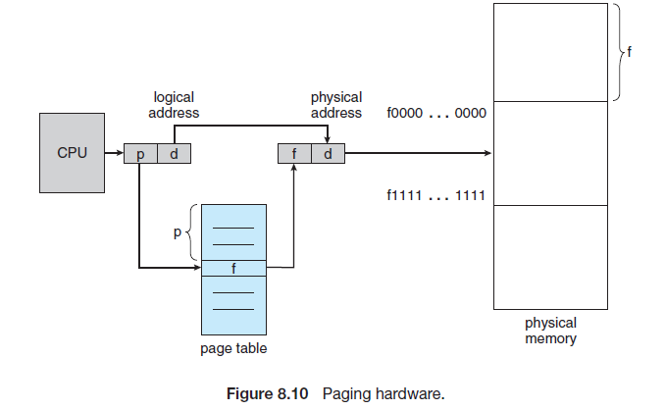
Memory Management
Paging – Hardware
02

Slide 144
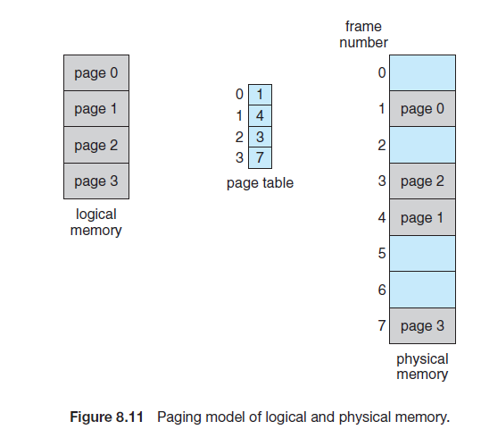
Memory Management
Paging –
02

Slide 145
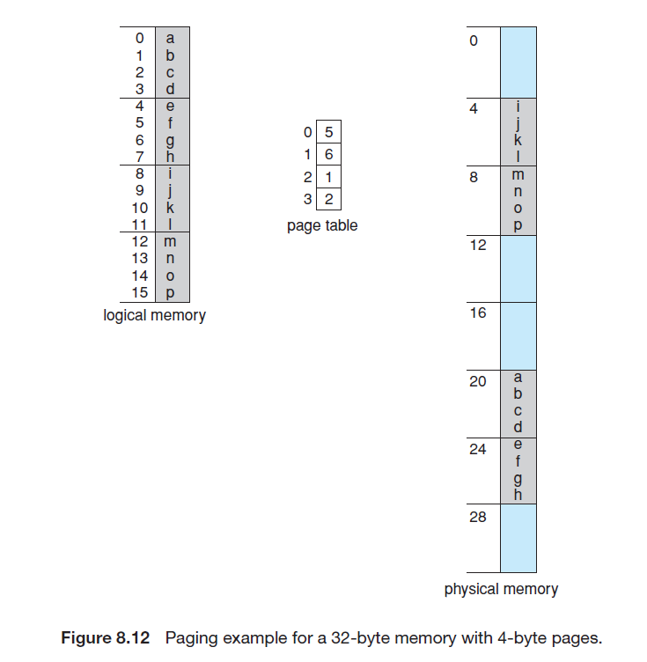
Memory Management
Paging –
02

Slide 146
Lecture - 12

Slide 147
Recap
Memory Management:
  Paging

Slide 148
Agenda
Memory Management:
  Paging
    Free Frames
    Hardware Support
    Protection
    Shared Pages

Slide 149
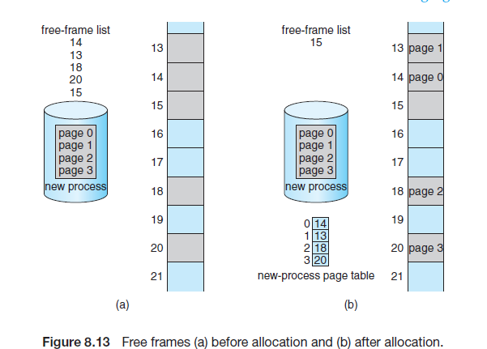
Memory Management
Paging – Free Frames
02

Slide 150
Memory Management
Paging – Hardware Support
Translation Look-Aside Buffer (TLB):
Special, small, fast lookup hardware cache called a Translation Look-aside Buffer (TLB).
The TLB is associative, high-speed memory.
Each entry in the TLB consists of two parts: a key (or tag) and a value.
When the associative memory is presented with an item, the item is compared with all keys simultaneously.
If the item is found, the corresponding value field is returned.
02

Slide 151
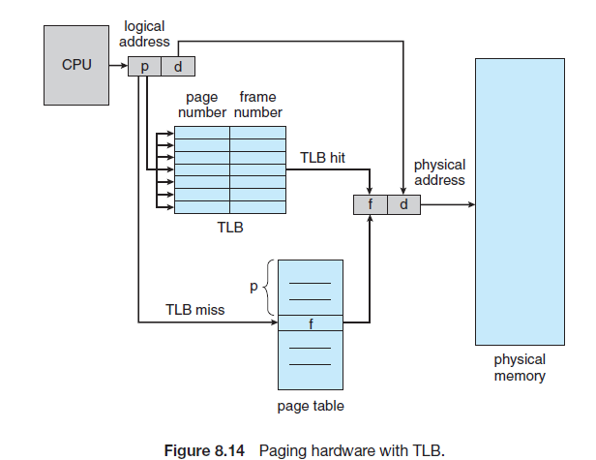
Memory Management
Paging – Hardware Support
Translation Look-Aside Buffer (TLB):
02

Slide 152
Memory Management
Paging – Hardware Support
Translation Look-Aside Buffer (TLB):
The TLB is used with page tables in the following way:
The TLB contains only a few of the page-table entries. When a logical address is generated by the CPU, its page number is presented to the TLB.
If the page number is found, its frame number is immediately available and is used to access memory.
02

Slide 153
Memory Management
Paging – Hardware Support
Translation Look-Aside Buffer (TLB):
If the page number is not in the TLB (known as a TLB miss), a memory reference to the page table must be made.
Depending on the CPU, this may be done automatically in hardware or via an interrupt to the operating system.
When the frame number is obtained, we can use it to access memory.
02

Slide 154
Memory Management
Paging – Protection
Memory protection in a paged environment is accomplished by protection bits associated with each frame.
Normally, these bits are kept in the page table.
One bit can define a page to be read-write or read-only.
Every reference to memory goes through the page table to find the correct frame number.
At the same time that the physical address is being computed, the protection bits can be checked to verify that no writes are being made to a read-only page.
An attempt to write to a read-only page causes a hardware trap to the operating system.
02

Slide 155
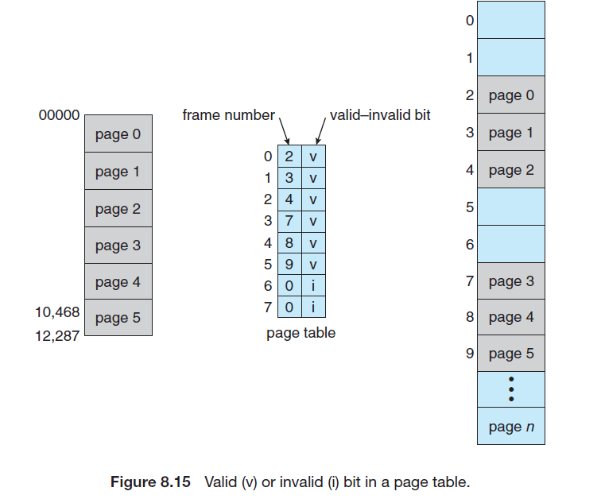
Memory Management
Paging – Protection
02

Slide 156
Memory Management
Paging – Protection
One additional bit is generally attached to each entry in the page table: a valid–invalid bit.
When this bit is set to valid, the associated page is in the process’s logical address space and is thus a legal (or valid) page.
When the bit is set to invalid, the page is not in the process’s logical address space.
Illegal addresses are trapped by the use of the valid–invalid bit.
The operating system sets this bit for each page to allow or disallow access to the page.
02

Slide 157
Memory Management
Paging – Shared Pages
An advantage of paging is the possibility of sharing common code.
This consideration is particularly important in a time-sharing environment.
02

Slide 158
Memory Management
Paging – Shared Pages
Consider a system that supports 40 users, each of whom executes a text editor.
If the text editor consists of 150 KB of code and 50 KB of data space, we need 8,000 KB to support the 40 users.
If the code is reentrant code (or pure code), however, it can be shared, as shown in Figure.
Reentrant code is non-self-modifying code: it never changes during execution. Thus, two or more processes can execute the same code at the same time.
02

Slide 159
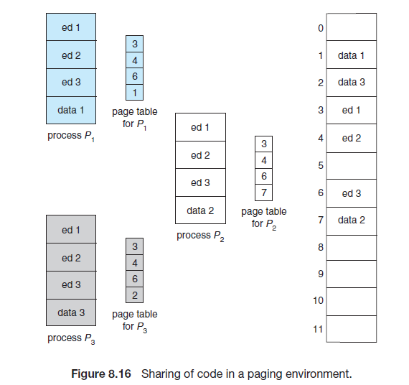
Memory Management
Paging – Shared Pages
02

Slide 160
Memory Management
Paging – Shared Pages
Here, we see three processes sharing a three-page editor—each page 50 KB in size (the large page size is used to simplify the figure).
Each process has its own data page.
02

Slide 161
Memory Management
Paging – Shared Pages
Only one copy of the editor needs to be kept in physical memory.
Each user’s page table maps onto the same physical copy of the editor, but data pages are mapped onto different frames.
Thus, to support 40 users, we need only one copy of the editor (150 KB), plus 40 copies of the 50 KB of data space per user.
The total space required is now 2,150 KB instead of 8,000 KB—a significant
savings.
02

Slide 162
Lecture - 13

Slide 163
Recap
Memory Management:
  Paging
    Free Frames
    Hardware Support
    Protection
    Shared Pages

Slide 164
Agenda
Virtual Memory

Slide 165
Virtual Memory
Code needs to be in memory to execute, but entire program rarely used
  Error code, unusual routines, large data structures
Entire program code not needed at same time
Consider ability to execute partially-loaded program
  Program no longer constrained by limits of physical memory
  Each program takes less memory while running -> more programs run at the same time
02

Slide 166
Virtual Memory
    Increased CPU utilization and throughput with no increase in response time or turnaround time
  Less I/O needed to load or swap programs into memory -> each user program runs faster
02

Slide 167
Virtual Memory
Virtual memory involves the separation of logical memory as perceived by users from physical memory.
This separation allows an extremely large virtual memory to be provided for programmers when only a smaller physical memory is available.
Virtual memory makes the task of programming much easier, because the programmer no longer needs to worry about the amount of physical memory available; she can concentrate instead on the problem to be programmed.
02

Slide 168
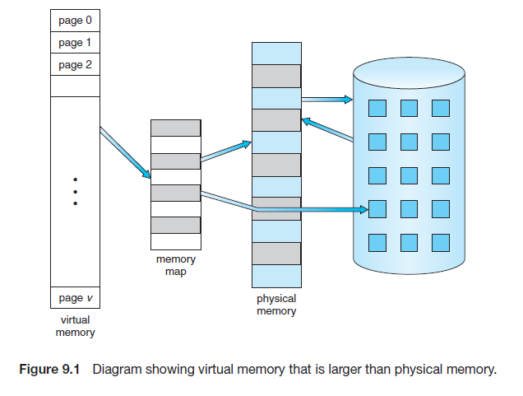
Virtual Memory
02

Slide 169
Virtual Memory
Virtual memory – separation of user logical memory from physical memory
  Only part of the program needs to be in memory for execution
  Logical address space can therefore be much larger than physical address space
  Allows address spaces to be shared by several processes
  Allows for more efficient process creation
  More programs running concurrently
  Less I/O needed to load or swap processes
02

Slide 170
Virtual Memory
Virtual address space – logical view of how process is stored in memory
  Usually start at address 0, contiguous addresses until end of space
  Meanwhile, physical memory is organized in page frames
  MMU must map logical to physical
Virtual memory can be implemented via:
  Demand paging
  Demand segmentation
02

Slide 171
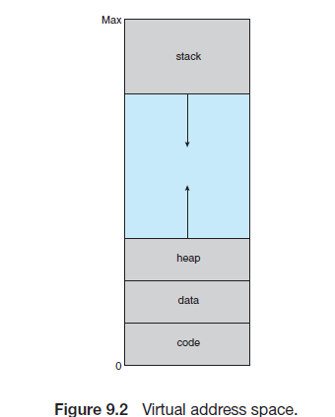
Virtual Memory
The large blank space (or hole) between the heap and the stack is part of the virtual address space but will require actual physical pages only if the heap or stack grows.
Virtual address spaces that include holes are known as sparse address spaces.
Using a sparse address space is beneficial because the holes can be filled as the stack or heap segments grow or if we wish to dynamically link libraries
02

Slide 172
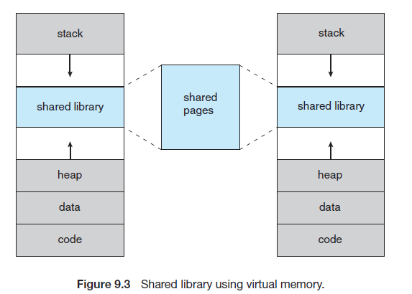
Virtual Memory
In addition to separating logical memory from physical memory, virtual memory allows files and memory to be shared by two or more processes through page sharing.
Benefits:
System libraries can be shared by several processes.
Processes can share memory
Pages can be shared during process creation with the fork() system call, thus speeding up process creation.
02

Slide 173
Demand Paging
Suppose a program starts with a list of available options from which the user is to select.
Loading the entire program into memory results in loading the executable code for all options, regardless of whether or not an option is ultimately selected by the user.
An alternative strategy is to load pages only as they are needed.
This technique is known as demand paging and is commonly used in virtual memory systems.
02

Slide 174
Demand Paging
With demand-paged virtual memory, pages are loaded only when they are demanded during program execution.
Pages that are never accessed are thus never loaded into physical memory.
02

Slide 175
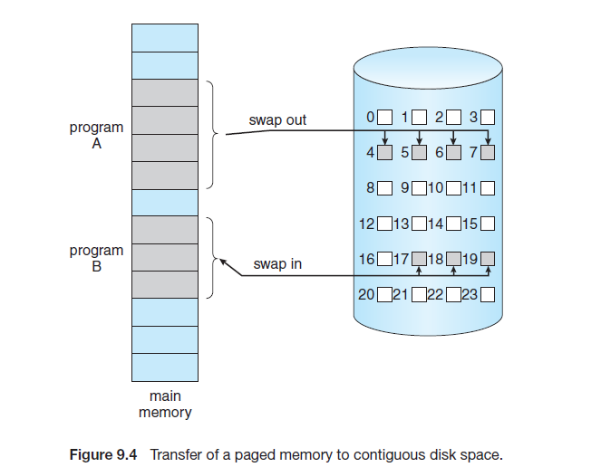
Demand Paging
02

Slide 176
Demand Paging
A demand-paging system is similar to a paging system with swapping where processes reside in secondary memory (usually a disk).
When we want to execute a process, we swap it into memory.
Rather than swapping the entire process into memory, though, we use a lazy swapper.
A lazy swapper never swaps a page into memory unless that page will be needed. In the context of a demand-paging system, use of the term “swapper” is technically incorrect.
02

Slide 177
Demand Paging
A swapper manipulates entire processes, whereas a pager is concerned with the individual pages of a process.
We thus use “pager,” rather than “swapper,” in connection with demand paging.
02

Slide 178
Demand Paging
Basic Concepts
With this scheme, we need some form of hardware support to distinguish between the pages that are in memory and the pages that are on the disk.
The valid–invalid bit scheme can be used for this purpose.
When this bit is set to “valid,” the associated page is both legal and in memory. If the bit is set to “invalid,” the page either is not valid (that is, not in the logical address space of the process) or is valid but is currently on the disk.
The page-table entry for a page that is brought into memory is set as usual, but the page-table entry for a page that is not currently in memory is either simply marked invalid or contains the address of the page on disk.
02

Slide 179
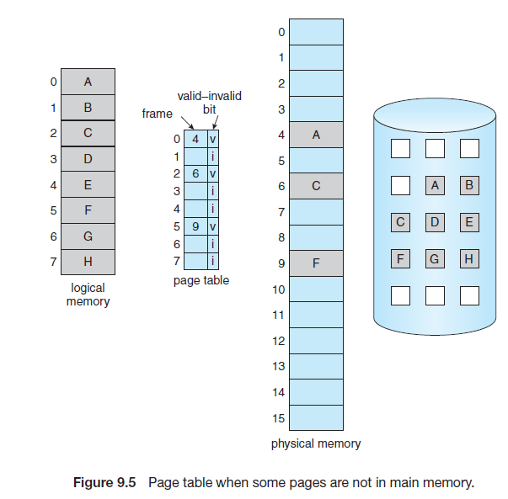
Demand Paging
Basic Concepts
02

Slide 180
Demand Paging
Page Fault
Access to a page marked invalid causes a page fault.
The paging hardware, in translating the address through the page table, will notice that the invalid bit is set, causing a trap to the operating system. This trap is the result of the operating system’s failure to bring the desired page into memory.
02

Slide 181
Lecture - 14

Slide 182
Recap
Virtual Memory
Demand Paging

Slide 183
Agenda
Page Fault

Slide 184
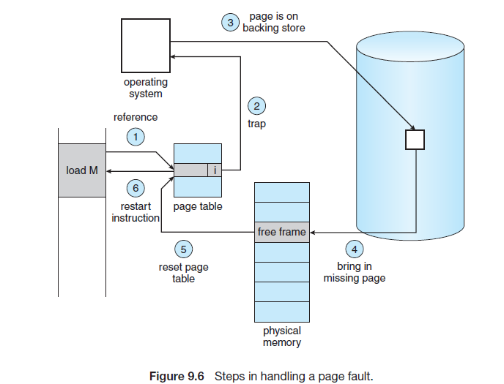
Page Fault
Access to a page marked invalid causes a page fault.
02

Slide 185
Page Fault
The procedure for handling this page fault is as follows:
Check an internal table (usually kept with the process control block) for this process to determine whether the reference was a valid or an invalid memory access.
If the reference was invalid, we terminate the process. If it was valid but we have not yet brought in that page, we now page it in.
Find a free frame (by taking one from the free-frame list).
Schedule a disk operation to read the desired page into the newly allocated frame.
02

Slide 186
Page Fault
When the disk read is complete, we modify the internal table kept with the process and the page table to indicate that the page is now in memory.
Restart the instruction that was interrupted by the trap. The process can now access the page as though it had always been in memory.
02

Slide 187
Page Replacement
While a user process is executing, a page fault occurs. The operating system determines where the desired page is residing on the disk but then finds that there are no free frames on the free-frame list; all memory is in use.
The most common solution: Page Replacement
02

Slide 188
Page Replacement
Page replacement takes the following approach:
If no frame is free, we find one that is not currently being used and free it.
We can free a frame by writing its contents to swap space and changing the page table (and all other tables) to indicate that the page is no longer in memory.
We can now use the freed frame to hold the page for which the process faulted.
02

Slide 189
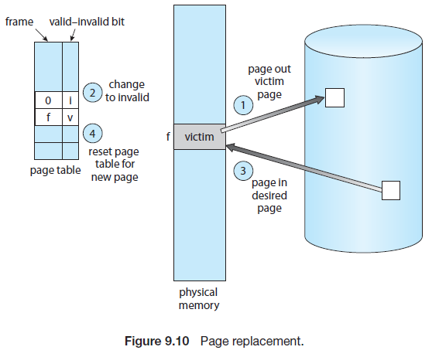
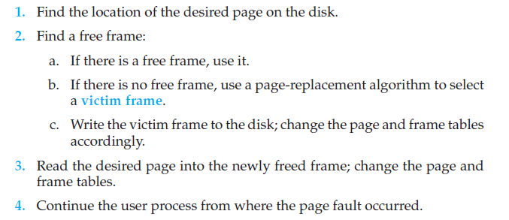
Page Replacement
02

Slide 190
Page Replacement
02

Slide 191
Page Replacement Algorithms
FIFO Page Replacement
Optimal Page Replacement
LRU Page Replacement
02

Slide 192
Page Replacement Algorithms
First In First Out (FIFO) Algorithm:
The simplest page-replacement algorithm is a first-in, first-out (FIFO) algorithm.
A FIFO replacement algorithm associates with each page the time when that page was brought into memory.
When a page must be replaced, the oldest page is chosen.
02

Slide 193
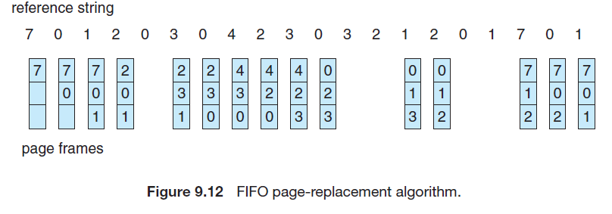
Page Replacement Algorithms
First In First Out (FIFO) Algorithm:
No. of Page faults = 15
02

Slide 194

Page Replacement Algorithms
First In First Out (FIFO) Algorithm:
Reference String:
1, 2, 3, 4, 1, 2, 5, 1, 2, 3, 4, 5
02

Slide 195
Page Replacement Algorithms
First In First Out (FIFO) Algorithm:
Reference String:
1, 2, 3, 4, 1, 2, 5, 1, 2, 3, 4, 5
02

Slide 196
Page Replacement Algorithms
First In First Out (FIFO) Algorithm:
Reference String:
1, 2, 3, 4, 1, 2, 5, 1, 2, 3, 4, 5
Notice that the number of faults for four frames (ten) is greater than the number of faults for three frames (nine)!
This most unexpected result is known as Belady’s Anomaly:
02

Slide 197
Page Replacement Algorithms
Optimal Page Replacement
The algorithm that has the lowest page-fault rate of all algorithms and will never suffer from Belady’s Anomaly.
Replace the page that will not be used for the longest period of time.
02

Slide 198

Page Replacement Algorithms
Optimal Page Replacement
No. of Page faults = 9
02

Slide 199
Page Replacement Algorithms
LRU Page Replacement
Least Recently Used (LRU) algorithm.
LRU replacement associates with each page the time of that page’s last use.
When a page must be replaced, LRU chooses the page that has not been used for the longest period.
02

Slide 200

Page Replacement Algorithms
LRU Page Replacement
No. of Page faults = 12
02

Slide 201
Page Replacement Algorithms
Given page reference string:
1,2,3,4,2,1,5,6,2,1,2,3,7,6,3,2,1,2,3,6
Compare the number of page faults for LRU, FIFO, and Optimal page replacement algorithm. Given Frame Size = 4
No. of Page faults :
LRU = 10
Optimal Replacement = 8
FIFO = 14
02

Slide 202
Lecture - 15

Slide 203
Recap
Page Fault

Slide 204
Agenda
Page Fault Exercises

Slide 205
Page Replacement Algorithms
Consider the Pages referenced by the CPU in the order 6, 7, 8, 9, 6, 7, 1, 6, 7, 8, 9, 1
No. of Page faults :
FIFO = 14
Optimal Replacement = 8
LRU = 10
02

Slide 206

Page Replacement Algorithms
First In First Out (FIFO) Algorithm:
No. of Page faults : 9
02

Slide 207

Page Replacement Algorithms
Optimal Page Replacement
No. of Page faults : 7
02

Slide 208

Page Replacement Algorithms
LRU Page Replacement
No. of Page faults : 10
02

Slide 209
Allocation of Frames
Self Study
02

Slide 210
Thrashing
Self Study
02

Slide 211
Unit Summary
Unit 2: Dead locks
Deadlocks: system model, Characterization, Deadlock prevention, avoidance and detection, Recovery from deadlock.
Memory Management: Logical and Physical address space, Swapping, Contiguous allocation, Paging, Segmentation, Segmentation with paging, Virtual memory -Demand paging and its performance, Page replacement algorithms, Allocation of frames, Thrashing.
07

Slide 212

Thank You

